Slide 1
Advanced Features in DATASTAGE 8.7
Any use, copying or distribution without written permission from UnitedHealth Group is prohibited.

Slide 2
Advanced Features in Data stage 8.7
Advanced Search Criteria &
Quick Find
Impact Analysis
Performance analysis
Resource Estimation
Parameter Set
Configure Data Flow View
Cross Project Compare
Compare against
Creation of Data Connection Object
Parallel Debugger
Import & Export improvements
Balanced Optimizer
Any use, copying or distribution without written permission from UnitedHealth Group is prohibited.

Slide 3
Advanced Search Criteria & Quick Find
Customers have built up their Data Stage repositories with literally tens of thousands of objects – jobs, job sequences, shared containers, table definitions, and more. Finding those objects can, at times, be a daunting task, even for the most organized and well documented repositories.
The 8.0 and 8.5/8.7 release adds new Quick and Advanced Find features to make it easier to locate objects and work with them.
Available at the top of the Repository View and from the toolbar, the Quick Find allows users to locate objects with the following capabilities.
Any use, copying or distribution without written permission from UnitedHealth Group is prohibited.

Slide 4
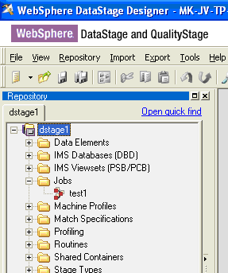
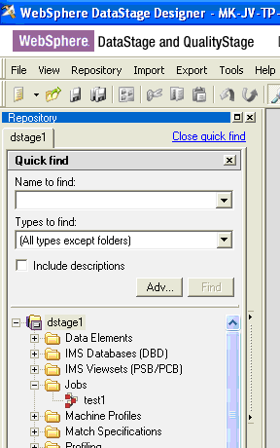
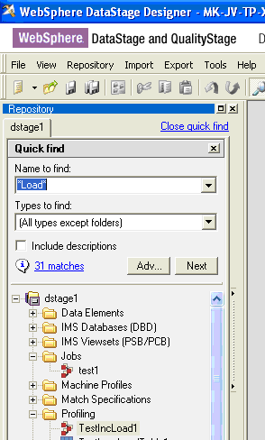
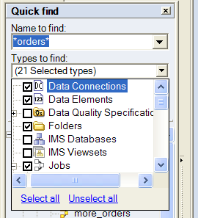
Usability: Quick Find - Basic
Find item in Repository tree
In-place find
Find by Name (Full or Partial)
Wild card support
Find next…
Filter on type

Slide 5
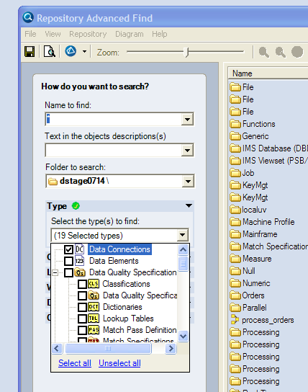
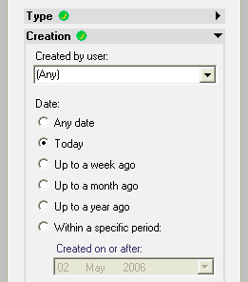
Usability: Find - Advanced Search Criteria
Search on following criteria:
Object type
  Job, Table Definition, Stage etc.
Creation
  Date/Time
  By User
Last Modification
  Date/Time
  By User
Where Used
  What other objects use this object?
Dependencies of
  What does this object use?
Options
Case
Match on “name & description” or “name or description”

Slide 6
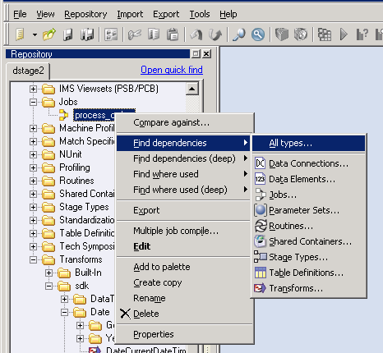
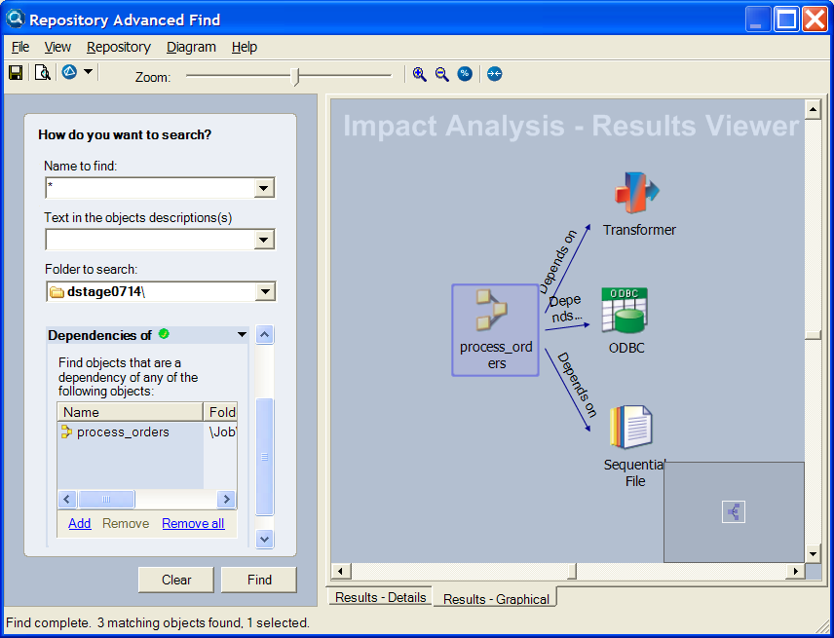
Usability: Impact Analysis - Graphical View
Impact Analysis:
Find dependencies
  …What does this item depend on?
Find where used
  …Where is this item used?
Results shown using the Advanced Find window

Slide 7
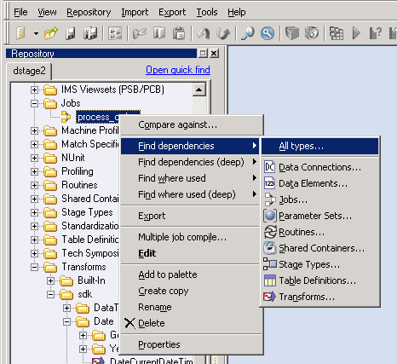
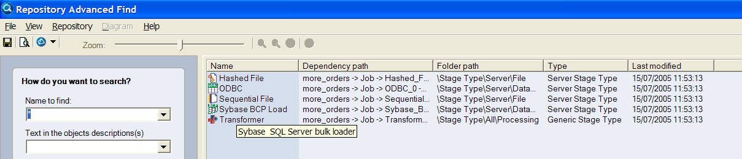
Usability: Impact Analysis – Tabular View
Results can be saved to html or xml file for additional processing or remote user viewing
Within application, results list can feed export, reporting or compilation functions

Slide 8
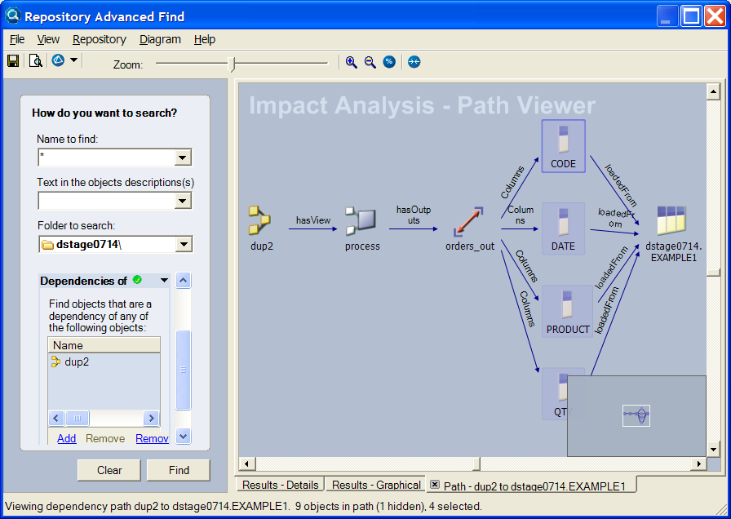
Usability: Impact Analysis – Path View
Allows selection of an object from result list and then shows where and how that object is used in a flow.
Object editor can be launched from this viewer
E.g. Job dup2 has a process stage, which has an orders_out output link, containing 4 columns,
which came from dstage014.EXAMPLE1 table

Slide 9
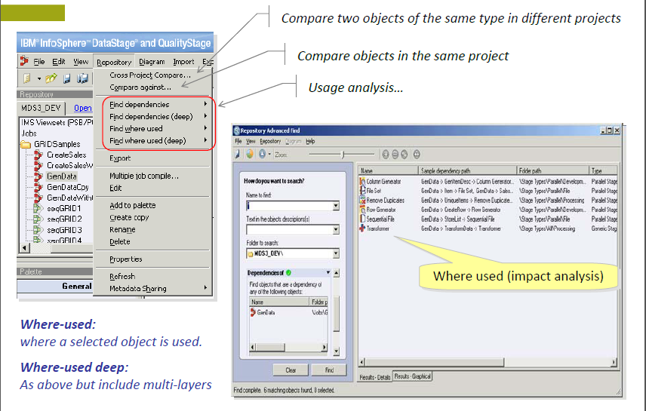

Repository Operations
Any use, copying or distribution without written permission from UnitedHealth Group is prohibited.

Slide 10
Performance analysis: Performance Improvements
Improved Job Startup Time
  Allow efficient use of DS EE against smaller data sets
Buffer Optimization
  Improved buffer placement algorithm
  E.g., Removed unnecessary buffer before parallel sort in some instances
Combinability Optimizations
  More combinable stages
  Intelligent combining
Adaptive Job Monitoring
  The Adaptive Job Monitoring feature detects when CPU utilization by the conductor reaches 80% and throttles the volume of job monitoring data
  Note: only monitor messages will be throttled, metadata and summary messages are not affected
  Time-based monitoring is now supported

Slide 11
Performance: Performance Analysis
Current Situation
Jobs were compared using Startup Time and Production Time.
Able to obtain totals for the functions of runtime
Able to watch Job Monitoring record throughput for job live, but this is not recorded for playback and throughput rates include time waiting for data
But…
Hard to determine the cause of a slow job
Larger jobs make troubleshooting nearly impossible
Long running jobs can’t be watched for record throughput changes throughout the run
What is happening on my machine(s)?

Slide 12
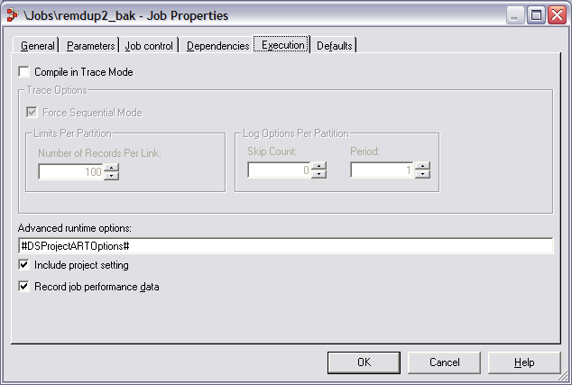
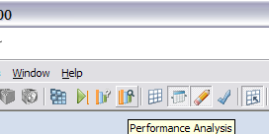
Performance: Enabling Performance Data Recording
Any job opened in the designer canvas may have performance information collected on it.
Simply choose ‘Record Job Performance Data’ in Job Properties.
Once a job run has completed, you may click on the Performance Analysis icon.
Enabling collection has little impact on overall job performance.

Slide 13
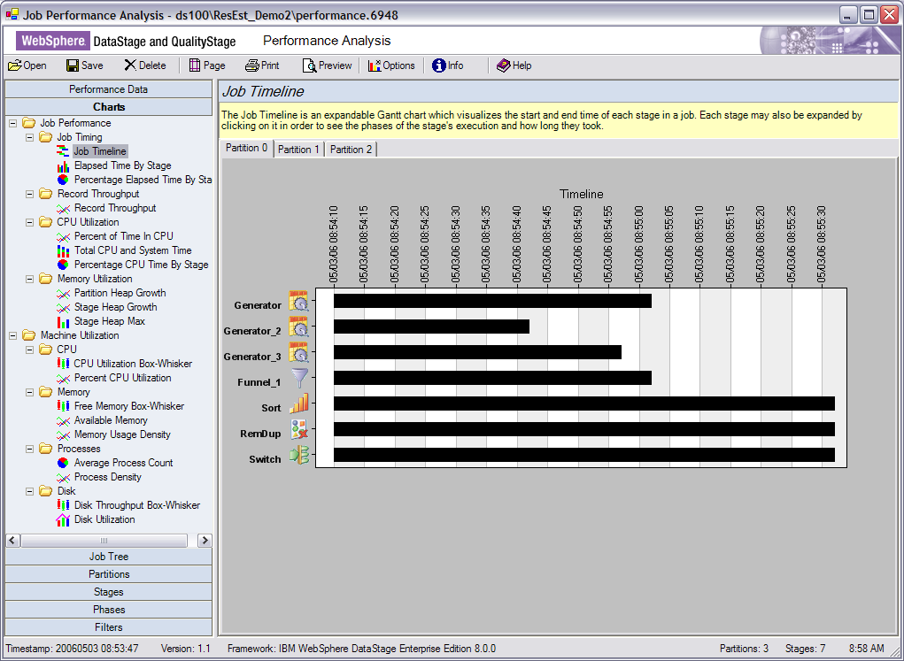
Performance: Job Performance Analysis
A new visualization tool which:
Provides deeper insight into runtime job behavior.
Offers several categories of visualizations, including:
  Record Throughput
  CPU Utilization
  Job Timing
  Job Memory Utilization
  Physical Machine Utilization
Hides runtime complexity by emphasizing the stages the customer placed on the designer canvas.

Slide 14
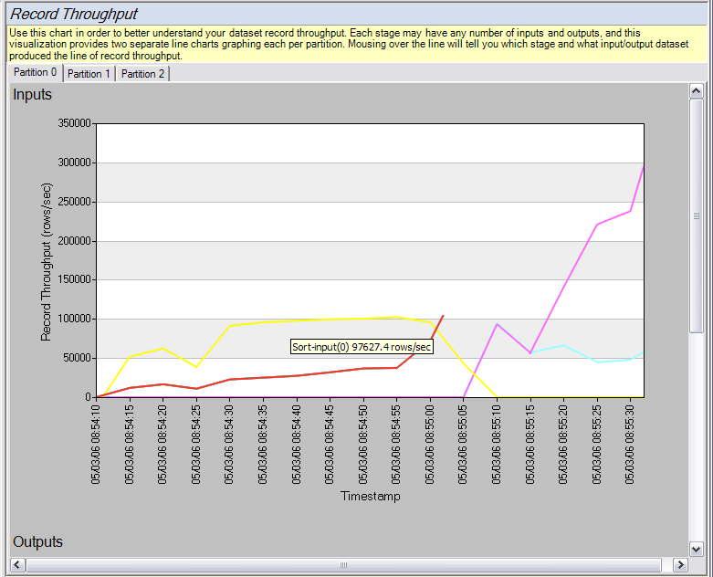
Performance: Record Throughput
Breakdown of records read and records written per second.
Filters to show one line for each link drawn on the canvas initially.
Names used to refer to each dataset are the actual stage names on the canvas.
Advanced users can turn off filters and see every runtime dataset, including the inner operators of composites, and inserted operator datasets.
One tab for each partition, as well as the ability to show an overlay view including every partition for smaller jobs.

Slide 15
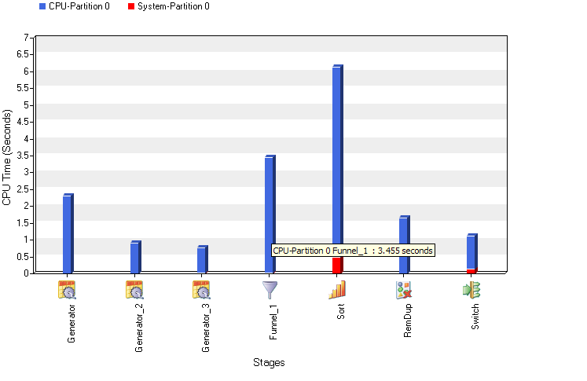
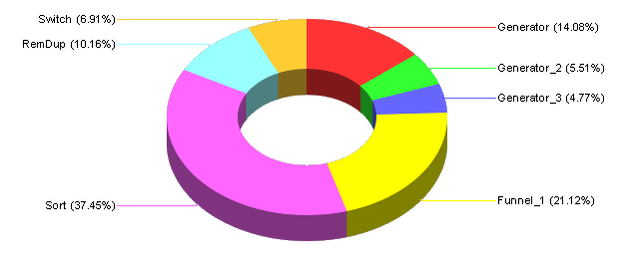
Performance: CPU Utilization
Total CPU and System Time
Visualizes the time in CPU of each operator.
Shows what operators were dominating the CPU at different points during the run.
Percentage view shows what percentage of the CPU load of the job each stage on the canvas was responsible for.
Inserted operators and Composite sub-operators automatically get bundled up in these results.
Advanced users can see combination, which will change this chart to reflect each process and the stages contained within.
Percentage CPU Pie Chart

Slide 16
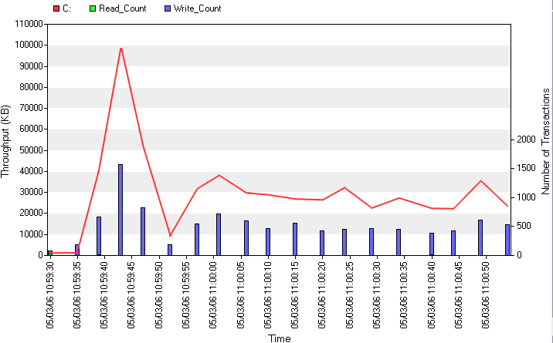
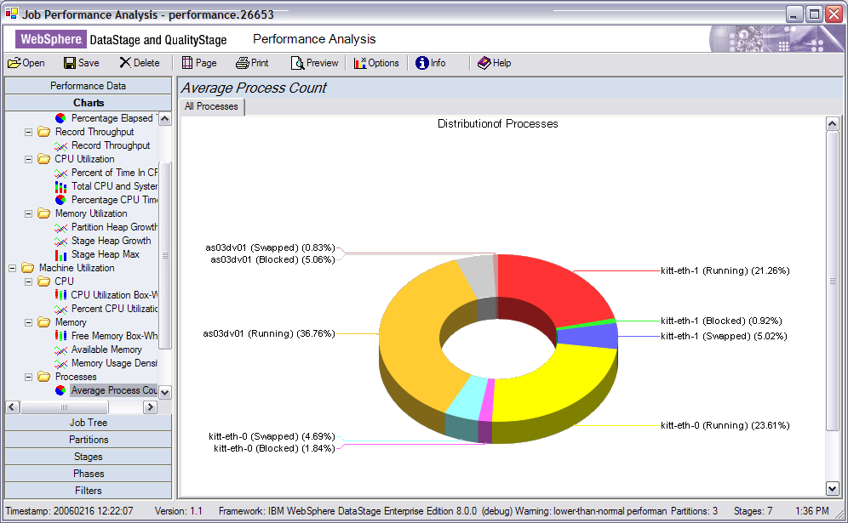
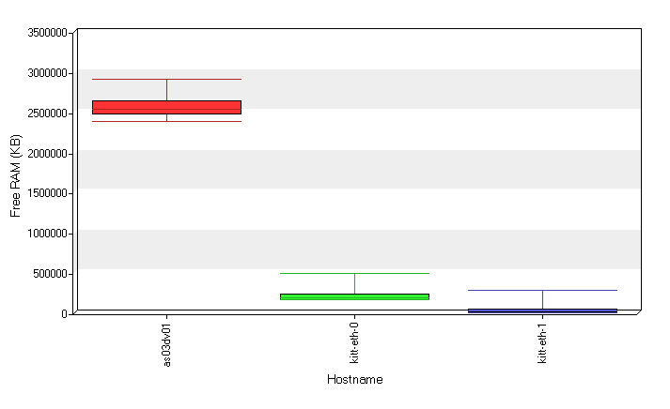
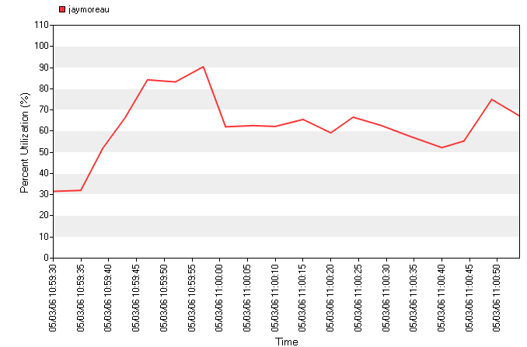
Performance: Physical Machine Utilization
Average Process Distribution
Disk Throughput
Free Memory Whisker Box
Percent CPU Utilization

Slide 17
Performance: Resource Estimation
Difficult to estimate resources required for job execution
  Scratch space, CPU, etc.
What happens if data volume increases?
How do I prevent job aborting due to lack of system resources?

Slide 18
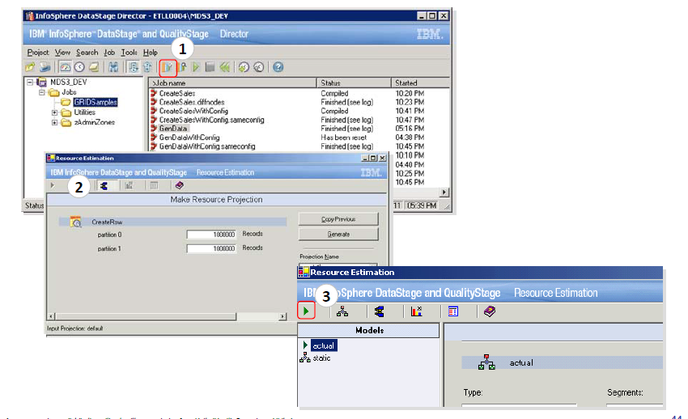
Resources Estimation
Any use, copying or distribution without written permission from UnitedHealth Group is prohibited.

Slide 19
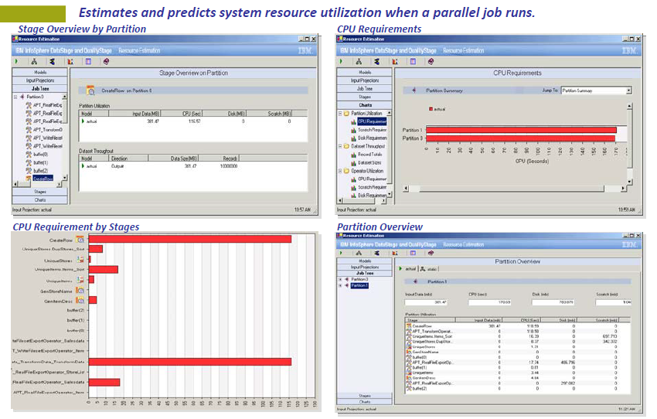
Resources Estimation –Cont.
Any use, copying or distribution without written permission from UnitedHealth Group is prohibited.

Slide 20
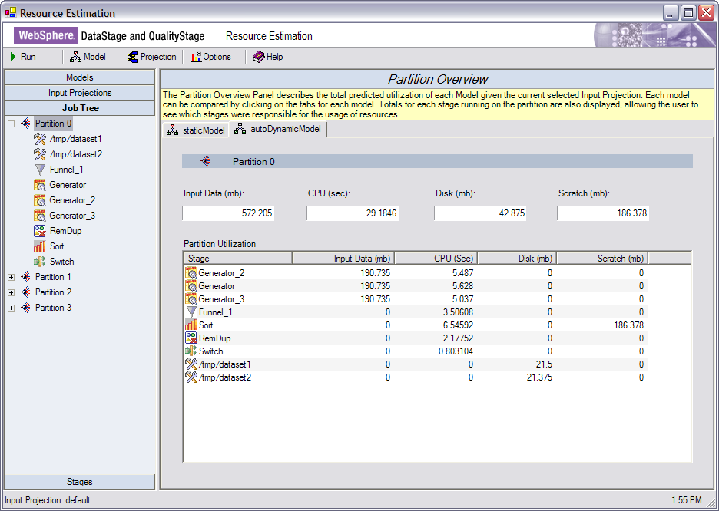
Performance: Resource Estimation Tool Layout Overview

Slide 21
Performance: What You Just Saw
Job Performance Analysis
  Record throughput by stage & partition, CPU utilization, memory and disk usage
  Overall Machine performance and information during job execution
    Correlated with job performance
  Can be used to identify performance bottlenecks, tune job design, determine what else is happening on the machine, etc.
Resource Estimation
  Predict system resources required for varying data volumes
  Assists in scheduling and managing job executions as well as preventing job aborts due to lack of system resources

Slide 22
Job Parameters
Job parameters make it easy to parameterize the job at execution time
What’s wrong with job parameters today?
  Can not easily share job parameters between jobs
  No mechanism in DataStage to easily manage and change job parameters when moving DataStage jobs through the product life cycle – Development, Test, System Test, Production

Slide 23
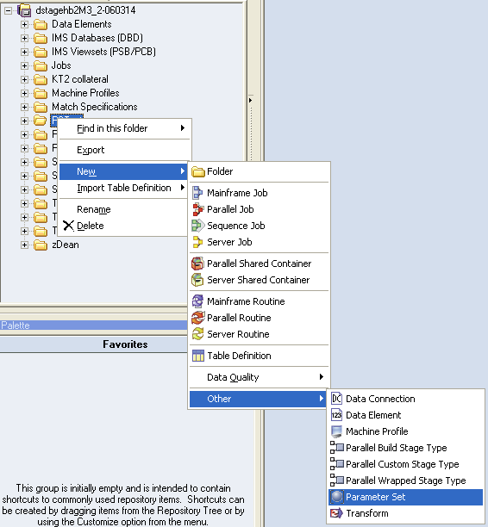
Job Parameters: Sets
New object in repository that contains the names and values of job parameters
A Parameter Set can be referenced by one or more jobs
Notes:
Screenshots show:
where Parameter Sets can be created
Where they can be added to the Job Properties dialog
New parameter type “Parameter Set”
Can still use individual parameters, parameter sets or combination of both

Slide 24
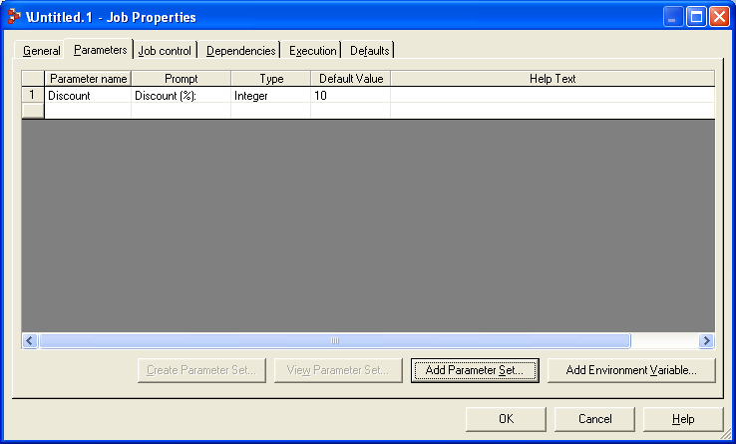
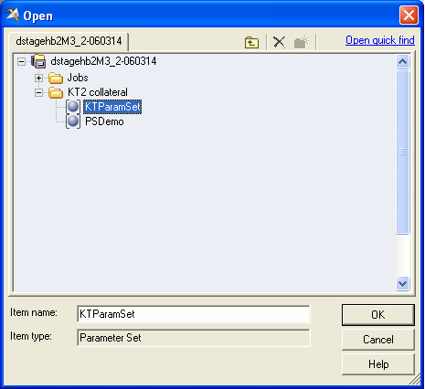

Job Parameters: Using Parameter Sets
Parameter sets can be used in combination within a job but they cannot currently be nested
Parameters in parameter sets are referenced using a ParameterSet.Parameter syntax
Notes:
Parameter Sets can be added to the Job Properties via the Parameter tab
..and appear in this form when loaded into a job component
e.g. #PSET1.param1# on a stage editor
When loading parameters, now see the available Parameter Sets, shown in expanded form in the selection tree
PSET1.param1
PSET1.param2
PSET2.param1
PSET2.param2

Slide 25
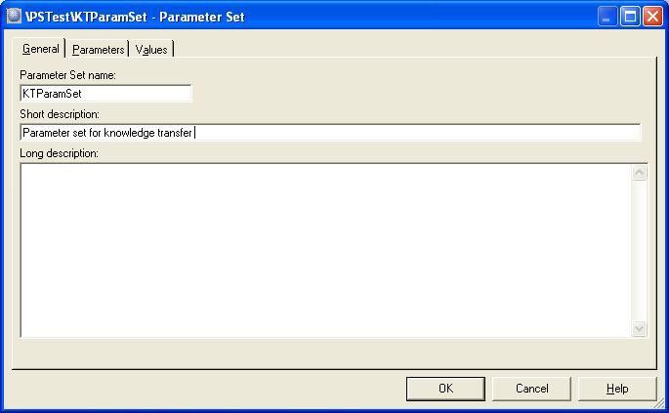
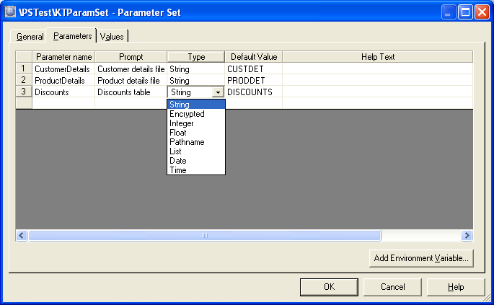
Job Parameters: Parameter Set dialog
The Parameters tab allows parameters to be added to the parameter set.
An environment variable
can also be added to
the parameter set.
Notes:
Parameter Set has a name & short/long descriptions
Parameters within the set are typed as with “normal” parameters
Incl. encrypted strings
Can also have environment variables added to the Parameter Set
Taken from the available env vars defined via the Admin client
Can only set the default value for an env var type

Slide 26
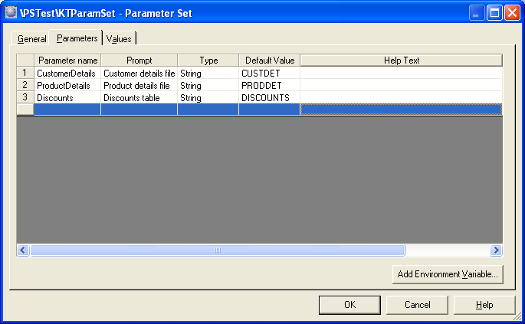
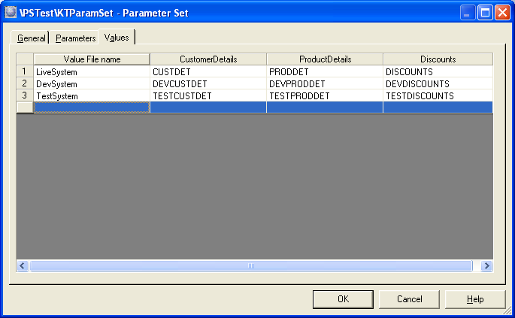
Job Parameters: Parameter Set dialog (cont.)
The Values tab is used to specify sets of values to be used for the parameters in this set when a job run.
Each set of values is stored in a file of the given name when the parameter set is saved.
Parameter set files are stored in a folder under the project folder – this is a static location
Notes:
Can be multiple value files per Parameter Set
Default file specified when adding the Parameter Set to a job
Stored in a dir on the DS Server
C:\IBM\WDIS\Classic\Server\DataStage\ParameterSets\<project>
Files consist of <name>=<value> pairs
Values file picked up at runtime based on finding a file with that name in this “well known” location

Slide 27
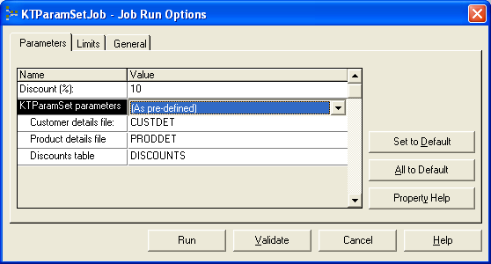

Job Parameters: Parameter Sets – Runtime
Parameter Sets included in Parameter list in the Job Run dialog
  Parameter Set names + parameter values shown
  Can select different Parameter Set value file
  Override individual parameter values
  Use the default values defined when the Parameter Set was created
dsjob...-param KTParamSet=TestSystem
Notes:
How are Parameter Sets handled at runtime?

Slide 28
Job Parameters: Benefits of Sets
Can use Impact Analysis to determine which Jobs are using a Parameter Set
Works for DataStage Server and DataStage Enterprise Edition
Easier to share job parameters across jobs
Easier to deploy jobs across machines
Easier to propagate a changed job parameter value

Slide 29
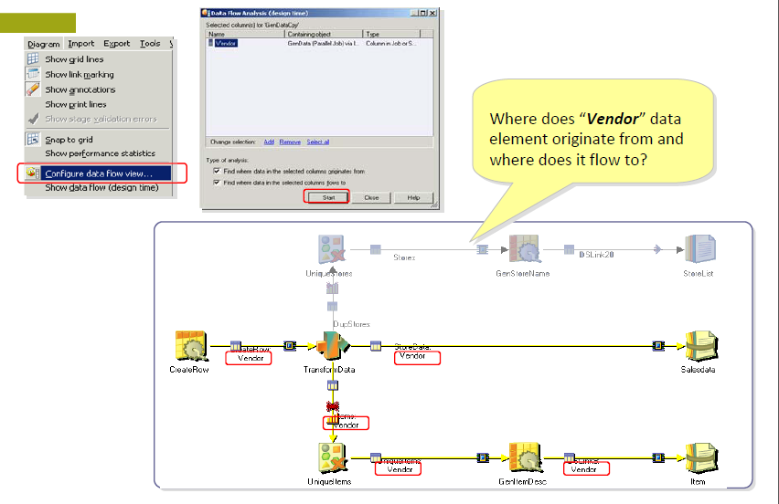
Data Flow at Design time
Any use, copying or distribution without written permission from UnitedHealth Group is prohibited.

Slide 30
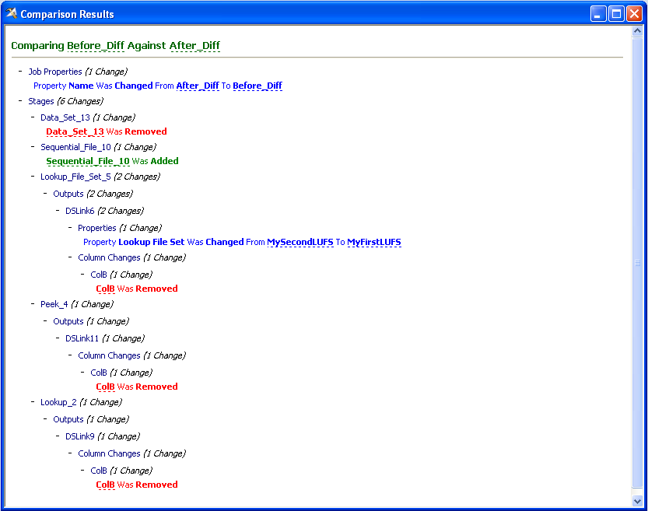
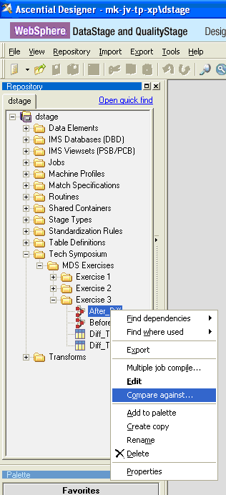
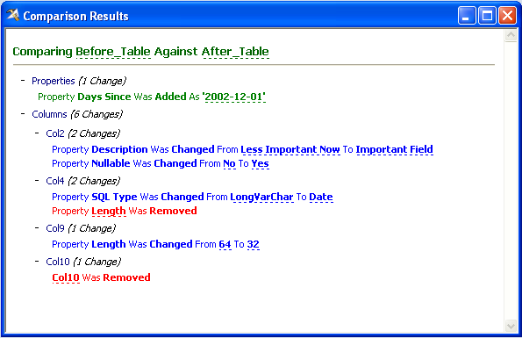
Usability: Job, Table or Routine Difference
Available for Jobs, Tables & Routines
Textual report with hot links to the relevant editor in Designer.
Tables →

Slide 31
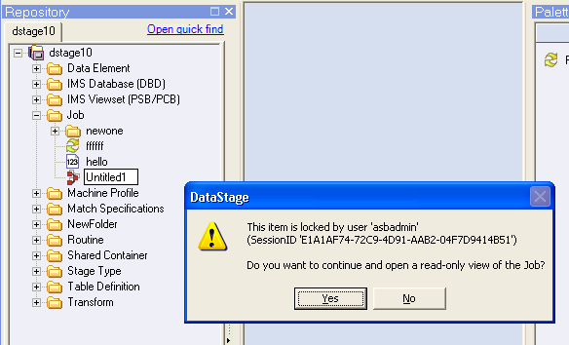
Usability: Collaboration - Multi-User Environment
Locking to prevent concurrent update clashes
Optional “read-only” view when items already locked in Repository
Visible lock “owner” to aid
identification
  By Name & Session ID
Identified user for “last modified” or “created by” actions
  Searchable using Advanced Find
  E.g. “Find all items created by user x today”
Notes:
Improvements over current locking mechanism…
If item is locked, get message indicating who’s editing it
Option to open the item in read-only mode, so not completely locked out
Visibility to user who last “touched” an object in the repos….

Slide 32
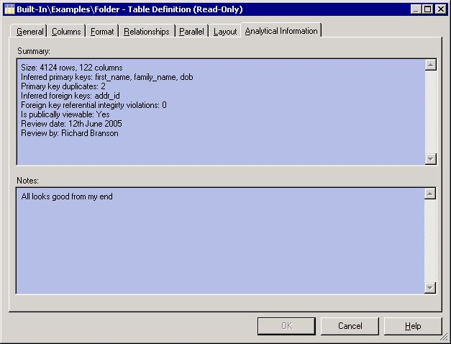
Usability: Metadata Sharing
DataStage, QualityStage & Information Analyzer
Sharing metadata with WebSphere Information Analyzer
  Both tools store Table metadata in the common repository
  DataStage users can see the table meta from Information Analyzer
    Allows sharing of metadata definitions
    Provides single metadata import from data source ~ for use in both tools
    Enables DS user to see IA analysis
    data for shared tables
Where is the IA analysis information
available in DS/QS Designer?
  “Analytical Information” tab on the
  EditRow dialog when looking at the
  details of an individual column from…
    …a Table Definition
    …a stage editor
  “Analytical Information” tab on the
  Table Definition dialog
Notes:
This is where we get the real benefit of the Common Repository…
WIA users can import Table meta data for their use, but this can be shared with DataStage users…

Slide 33
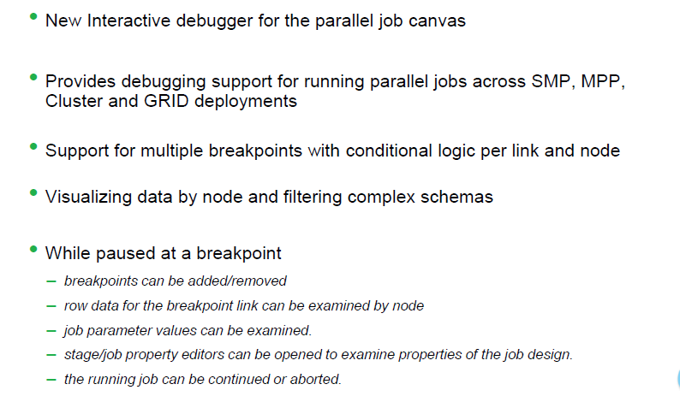
Parallel Job Debugging
An interactive debugger is an almost essential troubleshooting tool once one has reached the stage where a job runs to completion but does not produce the expected results.”
Any use, copying or distribution without written permission from UnitedHealth Group is prohibited.

Slide 34
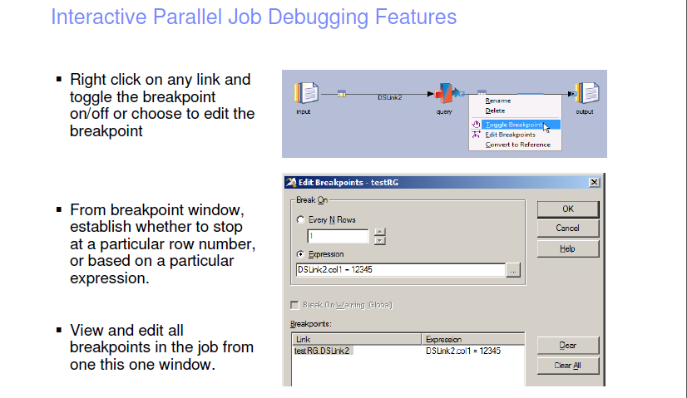
Any use, copying or distribution without written permission from UnitedHealth Group is prohibited.

Slide 35
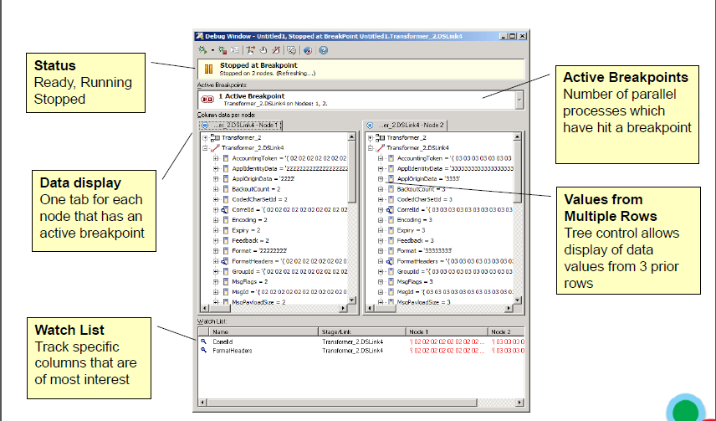
Interactive Parallel Job Debugging Features
Any use, copying or distribution without written permission from UnitedHealth Group is prohibited.

Slide 36
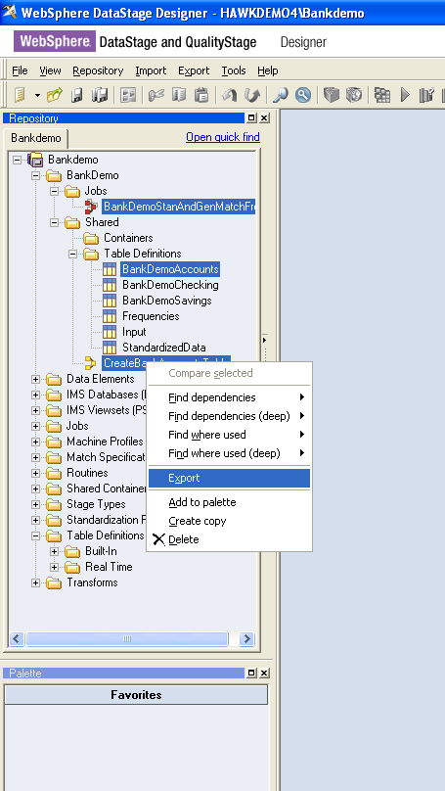
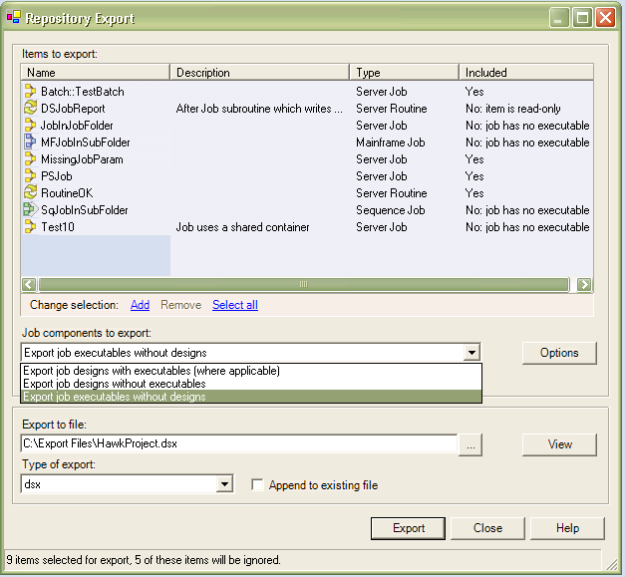
Usability: Export Improvements
Export launched from various places in the GUI
Available from
Export based on a result of a search

Slide 37
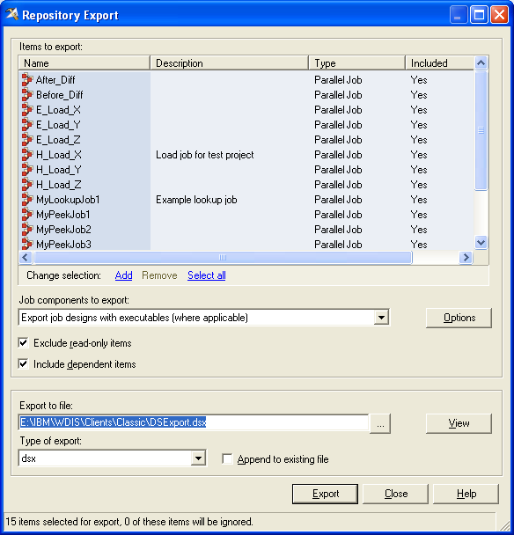
Usability: Export Improvements (cont.)
New Export Dialog
Allows export of items of different type:
  a single item
  all items in a folder
  a project
  several items of mixed type/folders
Export based on Search results
Allows export of dependent items

Slide 38
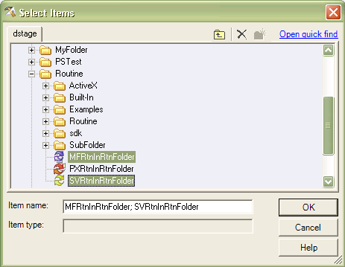
Usability: Export Improvements (cont.)
The new GUI allows modification of the original populated export list.
Items can be added, removed, filtered out.
Launching
point for
Quick Find!

Slide 39
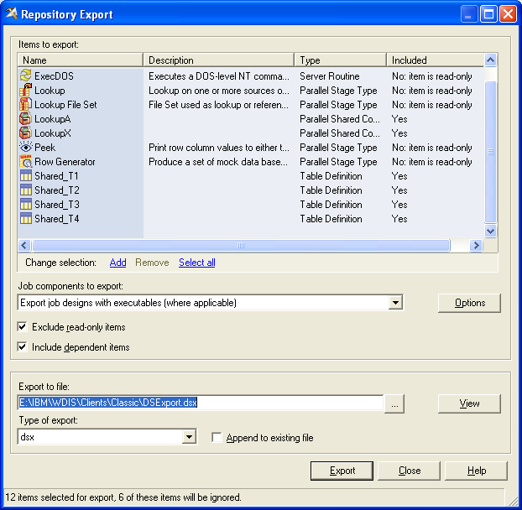
Usability: Export Improvements (cont.) – Filtering Options
Export filtering options allow:
To export job designs and/or executables
To filter Read-only items
All selected items are displayed
but some are excluded from export
based on the chosen criteria
Export Summary

Slide 40
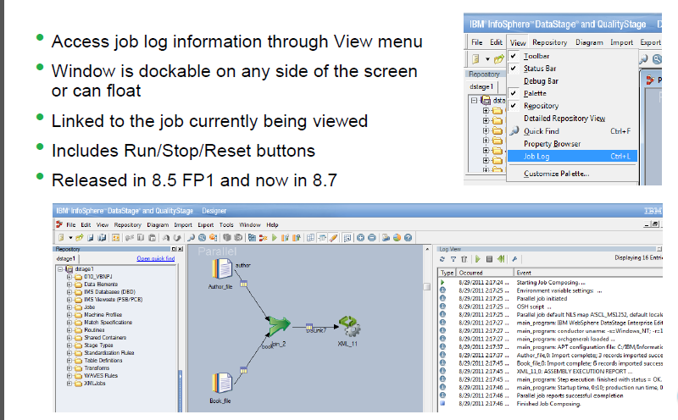
Job Log Now Available in Designer
Any use, copying or distribution without written permission from UnitedHealth Group is prohibited.

Slide 41
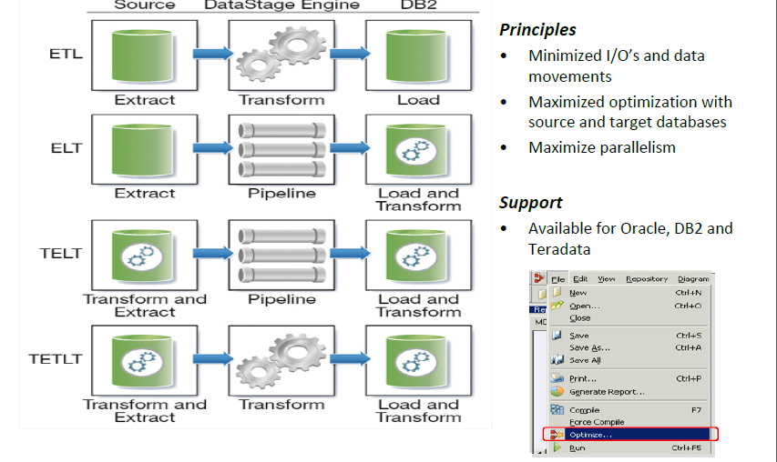
Balanced Optimization
Any use, copying or distribution without written permission from UnitedHealth Group is prohibited.

Slide 42
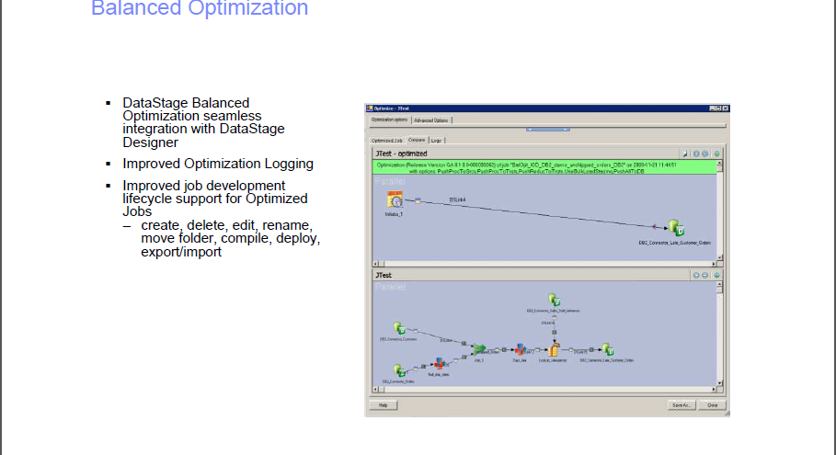
Any use, copying or distribution without written permission from UnitedHealth Group is prohibited.

